Slide 1
Topic:
Lane and traffic sign detection in a road scenario
DL Project Presentation
Team Details:
Shreyas K (106119064)
Rajneesh Pandey (106119100)
Satyarth Pandey (106119112)

Slide 2
Problem Statement
The problem of Road Lane Detection and signal detection is to find out the lane and traffic signs automatically for self driving cars. It is all due to the advancement in computer vision and deep learning that it become possible to detect road track from video frames and to detect traffic signs during the process of the self-driving.

Slide 3
Tools and Libraries Used
Code Run on :
Kaggle and Colab.
Major Library used :
PyTorch, NumPy,
OpenCV, Matplotlib,
Torchvision, pickle etc.

Slide 4
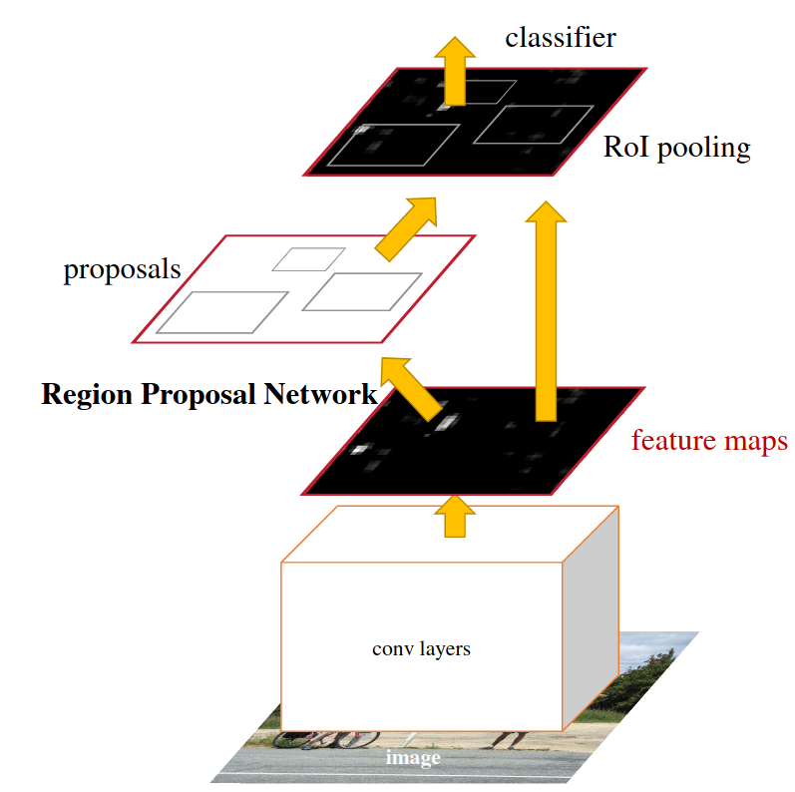
Traffic Sign Detection Model - Faster RCNN

Slide 5
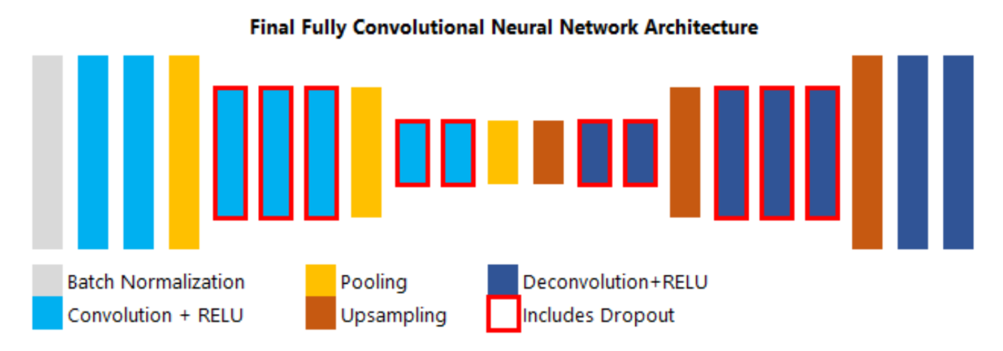
Lane Detection Model - Custom Deep NN

Slide 6
Details of Parameter and Hyperparameter
Hyper parameter
Learning rate = 0.0005
The learning rate defines how quickly a network updates its parameters.
Momentum = 0.9
Momentum helps to know the direction of the next step with the knowledge of the previous steps. It helps to prevent oscillations.
Number of epochs = 10
Number of epochs is the number of times the whole training data is shown to the network while training.
Batch size = 128
Mini batch size is the number of sub samples given to the network after which parameter update happens.

Slide 7
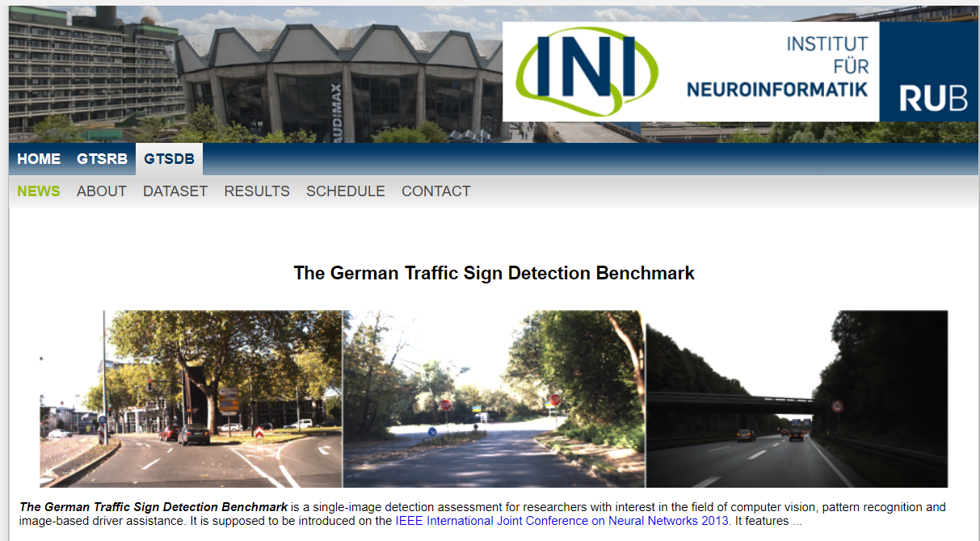
Dataset Used
The German Traffic Sign Detection Benchmark https://benchmark.ini.rub.de/gtsdb_news.html

Slide 8
Test Case
LIVE DEMO

